Slide 1
FY13 Collaboration Campaigns
Faith Wheller
Head of Collaboration Marketing Programs
Cisco

Slide 2
Agenda:
Collaboration Overview
Current Campaigns
Collaboration Breakaway PLUS
Collaboration Breakaway PLUS Mid Market
Win the Workspace with Jabber
Collaboration Breakaway PLUS Promotion
Partner Execution Options
What’s coming over the next 6 months?
Further Resources

Slide 3
Collaboration Overview

Slide 4

















What is Cisco Collaboration?
Unified Communications
IP Telephony
Voice end-points
Customer Collaboration
Contact Center (IVR & Analytics)
SERVICES
TelePresence
Executive, Room & Immersive
Collaboration Applications
WebEx
Jabber
WebEx Social (Quad)
CLOUD
ON PREMISE
Notes:
Cisco has market-leading components in each category, but the compelling story is in how they work together. Increasingly, leading industry analysts recommend that their clients take this sort of integrated portfolio approach when making strategic purchasing decisions.
Transition: I hope you now have a good sense of the breadth and range of the collaboration portfolio. I’d like to turn now to what makes it so cohesive, and that’s our collaboration architecture.

Slide 5
Campaigns

Slide 6
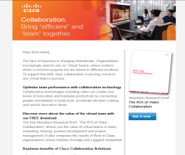

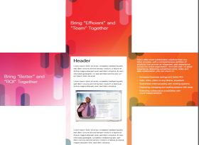

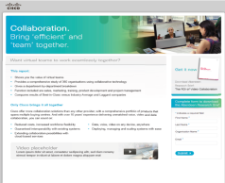
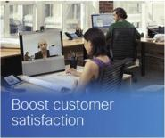
Collaboration Breakaway PLUS
What is it?
Integrated demand generation marketing campaign targeted at Commercial UC , Video & Greenfield accounts
Campaign Objectives:
Generate Leads and Drive Demand for Cisco Collaboration solutions (WebEx, TelePresence, Jabber and UC)
Campaign Messaging:
Based on Business Experiences faced by Business and Technical Decision Makers:
- Enable Mobile Productivity/BYOD
- Optimize IT resources
- Improve Customer Satisfaction
- Enhance Organizational Communications
- Improve Team Performance
Languages Available:
UK, FR, DE, IT, RU, ES (some others on request)

Slide 7




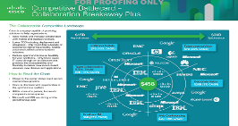





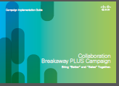




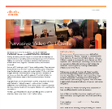
Campaign and Sales Enablement Deliverables
Social Media Guide
At a Glance
Landing Pages
Competitive Info
Online Banner Ads
Play Brief
Event in a Box incl PPT
Info-graphic
Emails
HTML 4
Campaign Implementation Guide
Video Montages
Whitepapers & 3rd party Reports
Direct Mail
Call Guide
Case Studies

Slide 8
Collaboration Breakaway PLUS Campaign Pick and Mix
Campaigns can be used Standalone
2 or more campaigns can be used as a mix and match
Campaigns can be run sequentially, in any order
Full asset deck can be used per campaign for a comprehensive campaign (recommended), or hand-picked for a bespoke campaign
Available Offers include:
Emails & Landing Pages
Copy Blocks
Web & Event Banners
Call Scripts
Sales Enablement Documents
Competitive Battlecards
Social Media Suggestions
Organizational Comms
Mobile Productivity
Customer Satisfaction
Optimizing IT
Team Performance

Slide 9
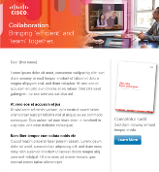
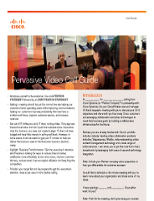
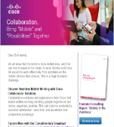






Mix & Match – Integrated Campaign Example
How do I generate pipeline through sales & marketing?
“I want to drive revenue around Video and Mobile Productivity”
Call Guide
Mix & Match Emails & Landing Pages
What are the financial incentives from Cisco?
Collaboration Breakaway PLUS Promo
Online Banner Ads
Whitepapers
& Reports
Social Media Guide

Slide 10
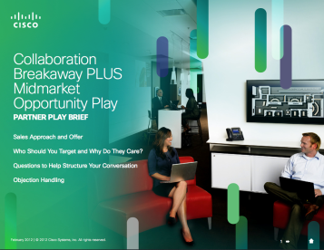
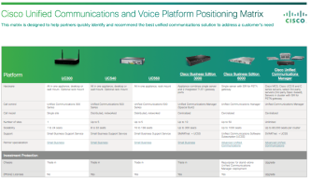
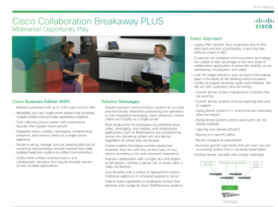
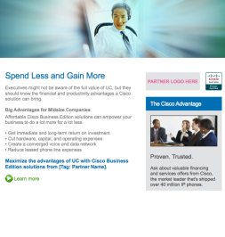
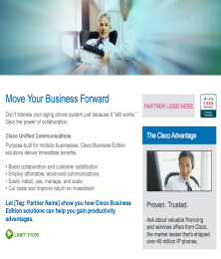
Collaboration Breakaway PLUS (Mid-Market)
What is it?
Integrated demand generation marketing focused on small to mid-market accounts particularly focusing on upgrading your installed base
Campaign Objectives:
Generate Leads and Drive Demand for Business Edition 6000 product through upgrading your installed base.
Campaign Messaging:
Within Collaboration Breakaway PLUS the mid market opportunity focus in 3 key customers care-about & explain Cisco solution benefits:
Optimize IT
Team Performance
Mobile Productivity
Assets Available:
Emails, call scripts, play brief, whitepaper
Languages Available:
UK, FR, DE, IT, ES, RU
Notes:
One virtualized box with applications

Slide 11
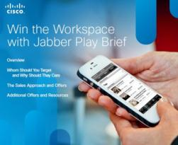
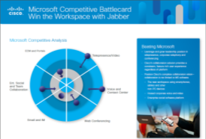
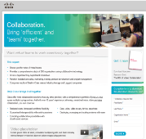

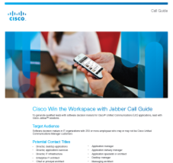
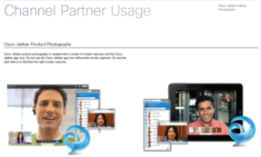
Win the Workspace with Jabber
What is it?
Integrated campaign to help you understand, build awareness, generate demand, and sell Jabber with other collaboration products
Campaign Objectives:
Generate Leads and Drive Demand for Cisco Jabber, Migrate/Upsell CUCM
Campaign Messaging:
Jabber for Everyone
Cisco vs Microsoft
Jabber – Work your Way
Available Assets:
3 x emails and landing pages
3rd party whitepapers
Videos
Call Guide
Languages:
UK, FR, DE, ES, IT, RU
Notes:
Jabber for Everyone - Enrich productivity with anytime, anywhere, on any device
Deliver the best user experience across PC, Mac, Tablet, Phone
Maximize cost savings through mobility, reducing travel/physical office space
Jabber Cisco vs. Microsoft
Investment protection: Office, SharePoint, etc. familiar app
Extend existing investments in standards based video
Achieve secure, reliable, communications across desktop and mobile devices
Save money/resources with a flexible architecture & choice of deployment models
Jabber Work Your Way
Increase productivity and flexibility: All the Places You Go: in the office, at home, on the road
Eliminate compromise on productivity- same experience from your mobile device to your desktop
Communicate from within familiar applications and business processes

Slide 12
Partner-led Execution

Slide 13
Execution Options – single or multiple campaigns
Talk to mConcierge in UKI/Germany/France to
try out this new service
mConcierge
Partner Demand Center
Work with Cisco Partner Demand Centre for Campaign Execution
Access the assets and resources from Cisco Partner Marketing Central to build and execute your own campaign
Partner Marketing Central Self Service

Slide 14
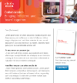





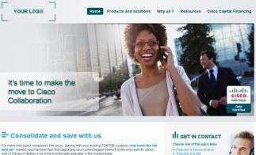

Campaign Flow Example – Partner Demand Center
PDC hosted
Gated Assets
PDC Executed Email.
Single/Multiple Emails
Single/Multiple Themes
PDC
Managed
Telequalification
PDC hosted
Microsite
MQL
Optional PDC
hosted Seminar

Slide 15
Campaign Flow Example – Partner Marketing Central
Partner Hosted
Gated Assets
Partner Executed
Individual or Multiple emails
Individual or multiple themes
Partner Sales Follow up
Landing Page
Partner Hosted Seminar
Leads

Slide 16
Collaboration Breakaway PLUS Promotion continuing into FY13
- Baseline and Accelerator Discounts apply to all eligible products
- Accelerators can be used independently or in combination
55%
Baseline
COMPETITIVE DISPLACEMENT
Call Control
Voicemail
Presence
Conferencing
Telepresence Endpoints
UPGRADES
Call Control
Voice & Video Endpoints
+5% Voice & Video Accelerator
CUCM Mandatory
10% of the HW endpoints must be Video
+4% Collaboration Accelerator
50% of Total Software Licenses in BOM through a combination of the following:
CUWL, Webex, Jabber, WebEx Social and Contact Center
UCSS Required if available
Minimum of 10% of BOM List Price
65% Special Incentives
Available for all baseline eligible deals
Cius & Accessories – VXC – BE6K CUWL Bundle – UCS – CUWL Migration – CUBE – TelePresence Touch – TelePresence Server – TMS – Packaged CCE
Seeding Incentives
Available for all baseline eligible deals
Cius 10 for 5 – VXC X for Y – EX60 4 for 2

Slide 17
What’s coming soon?

Slide 18
Collaboration Play Timeline
FY`12
FY`13
Q3
Q4
Q1
Q2
Q3
Q4
Fall Launch
Oct . 2-9
Spring Launch
Introduce: Get Ready to Innovate with Collaboration
(GMP structure theme)
Plays:
Collab in the Cloud (xSell)
Innovate with Voice & Video on
the Desktop (Migrate/Upsell)
BYOD Smart Solution
(xArch xSell)
Innovate with Visual Collaboration
Mid-Market Solutions
(xArch Acquire)
Pervasive Video
CB PLUS
Mid Mkt
(BE 6000)
CB PLUS
(Phase II DG)
Win the Workspace With Jabber Play
Microsoft Compete
(Acquire)
Customer Collaboration
* Placeholder names

Slide 19


Additional Resources available for partners
Product
Information
Partner Marketing Central
Useful Sites
Collaboration Breakaway PLUS:
https://emea.ciscopartnermarketing.com/Orgs/Initiative.aspx?id=936
Collaboration Breakaway PLUS Mid-Market
https://emea.ciscopartnermarketing.com/Orgs/Initiative.aspx?id=1501
Win the Workspace with Jabber:
https://emea.ciscopartnermarketing.com/Orgs/Initiative.aspx?id=1514
Collaboration Breakaway PLUS promotion:
www.cisco.com/go/cbplus
Cisco Business Edition 6000 Solution Resources: www.cisco.com/go/be6000
Cisco Jabber: www.cisco.com/go/jabber
Partner Facing Collaboration Business Experience tool:
http://www.cisco.com/assets/swa/flash/partners/collab_business_exp_tool/horizontal_external_en.html#/welcome
Cisco Brand Exchange:
www.bx.cisco.com
Collaboration Social Pages:
http://socialmedia.cisco.com/collaboration
For any Collaboration campaign specific enquiries please contact Faith Wheller (fwheller@cisco.com) or
Petra Almering (pealmeri@cisco.com)
Notes:
19
19

Slide 20
Polling Slide

Slide 22
PMC URLs – Collaboration Breakaway PLUS
Language | Link
English | https://emea.ciscopartnermarketing.com/Orgs/Initiative.aspx?id=936
Russian | https://emea.ciscopartnermarketing.com/Orgs/Initiative.aspx?id=1274
German | https://emea.ciscopartnermarketing.com/Orgs/Initiative.aspx?id=1025
Italian | https://emea.ciscopartnermarketing.com/Orgs/Initiative.aspx?id=1044
Spanish | https://emea.ciscopartnermarketing.com/Orgs/Initiative.aspx?id=1679
French | https://emea.ciscopartnermarketing.com/Orgs/Initiative.aspx?id=1030
To View the Campaign Implementation Guide Click here: http://www.foxps.com/client_downloads/cisco-implementation-guide2/
To view Partner Flyer: Click here: https://emea.ciscopartnermarketing.com/Orgs/Initiative.aspx?id=936

Slide 23
PMC URLs – Collaboration Breakaway Mid Market
Play | Language | Link
Collaboration Breakaway PLUS Mid market
 | English | https://emea.ciscopartnermarketing.com/Orgs/Initiative.aspx?id=1501
 | Russian | https://emea.ciscopartnermarketing.com/Orgs/Initiative.aspx?id=1736
 | German | https://emea.ciscopartnermarketing.com/Orgs/Initiative.aspx?id=1744
 | Italian | https://emea.ciscopartnermarketing.com/Orgs/Initiative.aspx?id=1745
 | Spanish | https://emea.ciscopartnermarketing.com/Orgs/Initiative.aspx?id=1738
 | French | https://emea.ciscopartnermarketing.com/Orgs/Initiative.aspx?id=1743

Slide 24
PMC URLs – Win the Workspace with Jabber
Play | Language | Link
Win the Workspace with Jabber
 | English | https://emea.ciscopartnermarketing.com/Orgs/Initiative.aspx?id=1514
 | German | https://emea.ciscopartnermarketing.com/Orgs/Initiative.aspx?id=1505
 | Italian | https://emea.ciscopartnermarketing.com/Orgs/Initiative.aspx?id=1558
 | Spanish | https://emea.ciscopartnermarketing.com/Orgs/Initiative.aspx?id=1504
 | French | https://emea.ciscopartnermarketing.com/Orgs/Initiative.aspx?id=1500

Slide 25
声明：
所有的版权属于原有公司，文件均来自公开渠道
此文件仅供学习使用，任何人不得进行以此为商业目的的行为
如有疑问，请立即删除
学习世界五百强和咨询公司PPT课程请访问如下网站搜索：“司马懿”
百度传课：司马懿PPT学校
网易学堂：司马懿PPT学校
知乎： 司马懿PPT学校
访问地址
https://www.chuanke.com
访问地址
https://study.163.com
访问地址
https://www.zhiu.com

